Slide 1
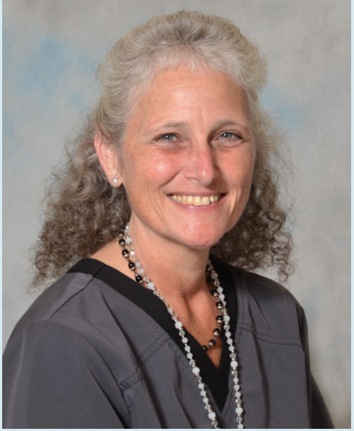
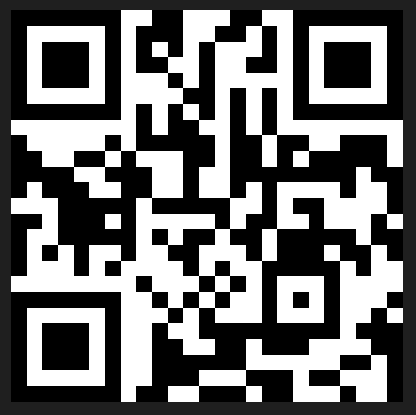
ONCOLOGIC EMERGENCIES
July 25, 2024 (Thursday)
Virtual only!
Deadline for Registration: July 23, 2024
6 p.m-8 p.m.
Scan QR CODE to Register!
Mary Jo Sarver
ARNP, AOCN, CRNI, VA-BC, LNC
Providence Regional Cancer Center, Everett

